Slide 1


USearch
Data Processing
Workshop Ⅱ
PROJECT
Jiayun XU 1930026140
Yuhan ZHENG 1930026174
Zhuoheng MA 1930026096

Slide 2

CONTENTS
1
2
3
4
Introduction
& Demo
Webserver
& Interface
Text files collection
TF-IDF &
Elastic search

Slide 3


01
Introduction
3

Slide 4
Introduction
Main Task: Retrieve text contents related to the query and order them according to relevance
Own
Webpage
20-thread Spider
Elastic
Search
RDD
2020 ©ypppt!
www.ypppt.com
4

Slide 5
Demo
Time

Slide 6
02
Webserver
& Interface
6

Slide 7



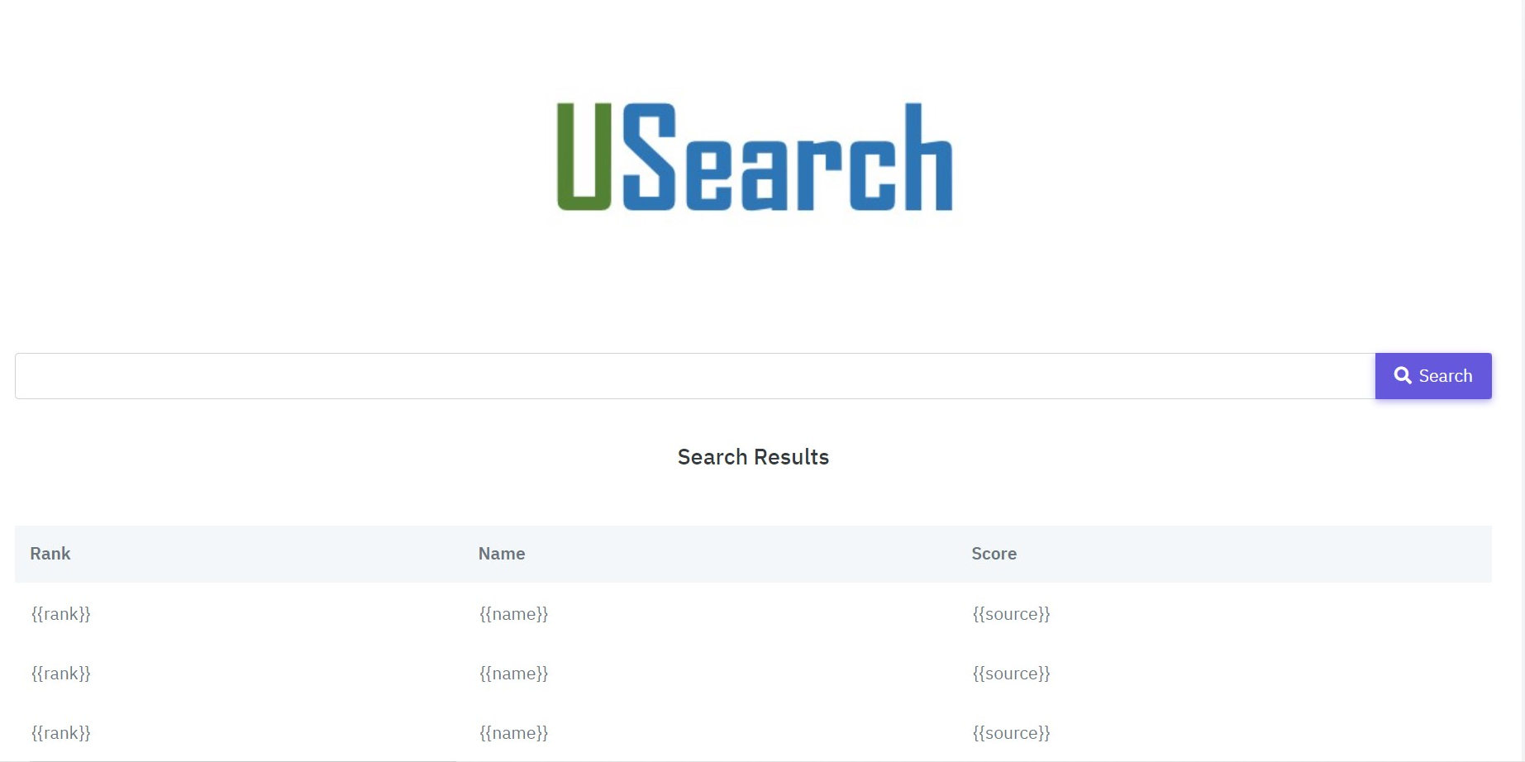
Web
development
tools
Search box
Table
2020 ©ypppt!

Slide 8
03
Text files collection
8
To believe,
To go beyond

Slide 9
A good First Step Solving half of the problem
High-quality,
our Attitude
100%
To believe,
To go beyond
Our Data Preprocessing – Text collection
300%
Transcend oneself
9

Slide 10
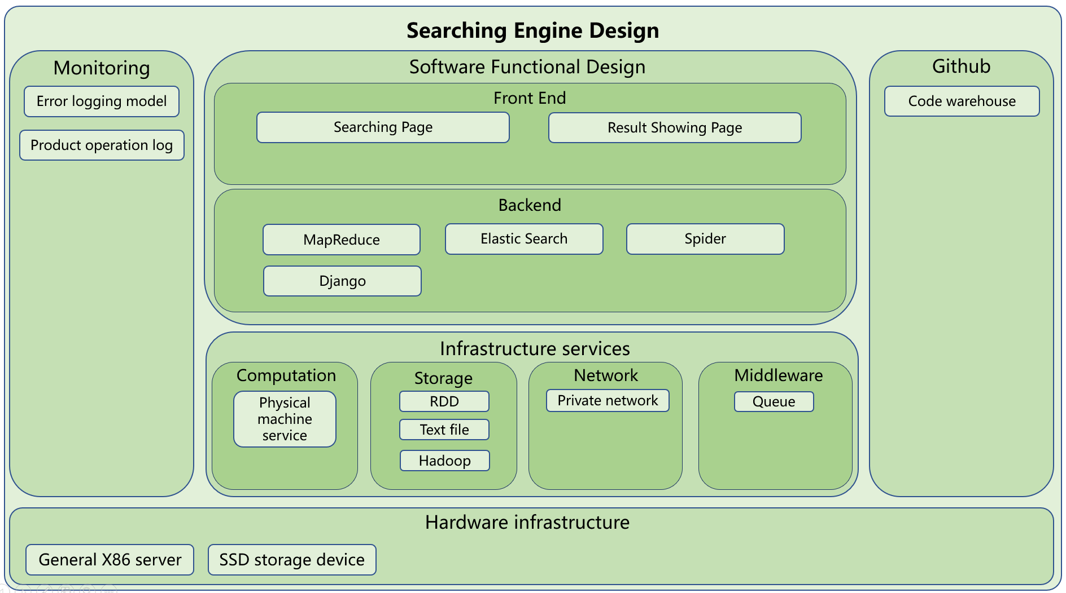
System Design
100%
300%
Transcend oneself
10

Slide 11

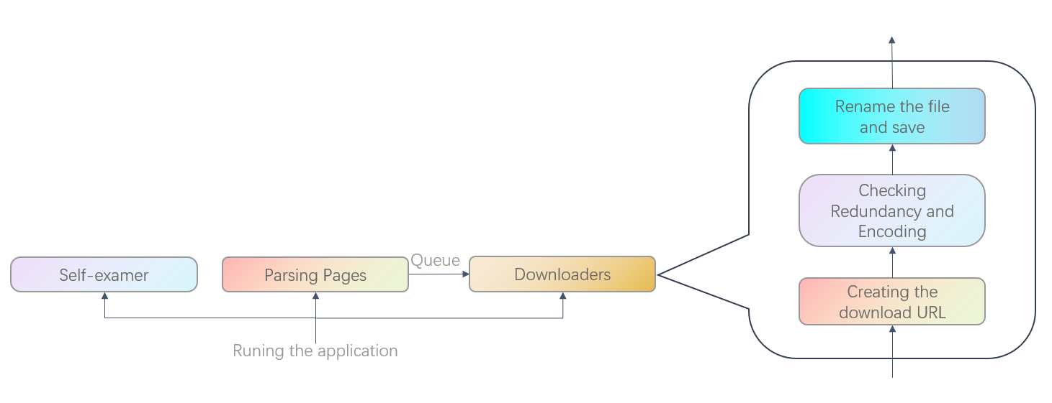
20-Threads Spider
Spider
Keep Going on!
Powerful = Complex?
No!
Also simple to use!
Only 10 sec,
you can have the ability to use all functions smoothly!
Spider
11

Slide 12
20-Threads Spider
Spider
Simple, but not “simple”
Attitude – go beyond powerful!
Keep Going on!
As it’s a tool that we can repeatedly using, we design it as simple as it can be to be friendly to the user!
Powerful = Complex?
No!
Also simple to use!
Only 10 sec,
you can have the ability to use all functions smoothly!
Powerful
95%
Easy Use
90%
Spider
12

Slide 13
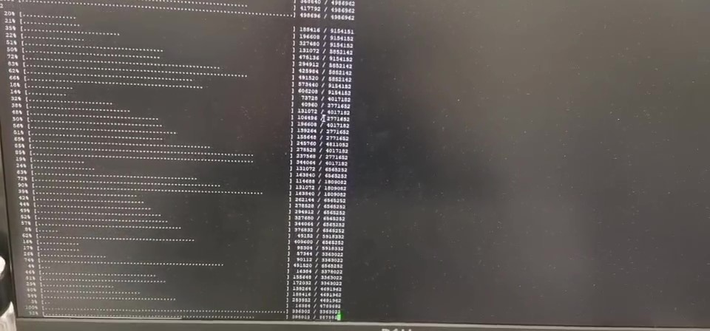

20-Threads Spider
Beyond Great
Speed Up! Up! Up!
10MB/s
Robustness
Reconnect after disconnection
Powerful
Automatically rename the files
2,500 books only take 5 min!
13

Slide 14
04
TF-IDF
& Elastic search
14

Slide 15
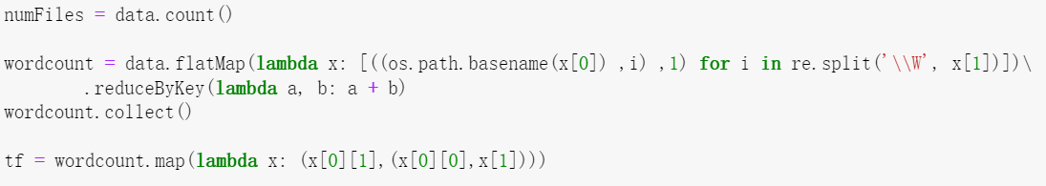
Term frequency
Term frequency
Indexing code
Indexing files
Indexing time
Count number of files
Regular expression to get file name
Count the number of words
Ranking
Elastic search
15

Slide 16
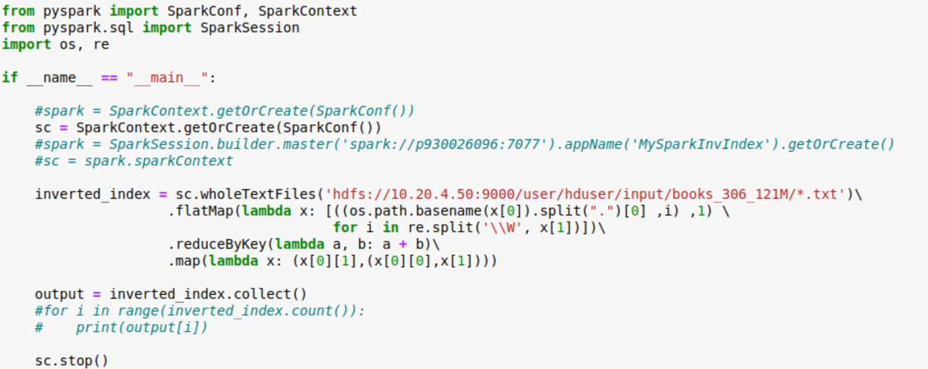
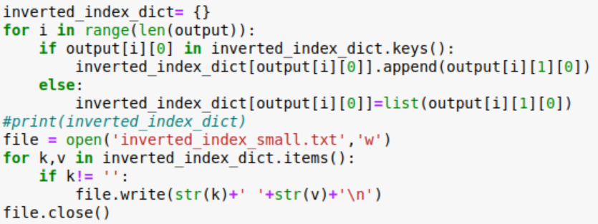
Indexing code
Term frequency
Indexing code
Indexing files
Indexing time
Ranking
Elastic search
The same with term frequency
Dictionary word(key):document list(value)
16

Slide 17
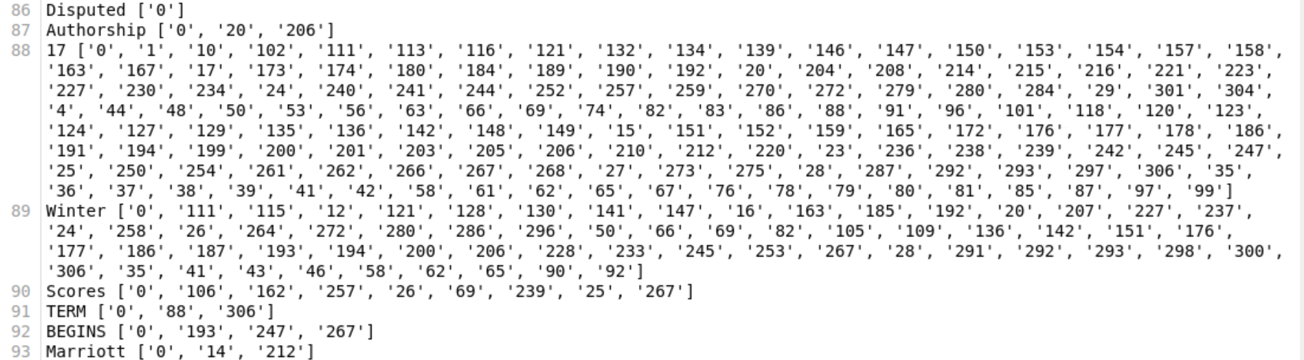
Indexing files
Term frequency
Indexing code
Indexing files
Indexing time
Ranking
Elastic search
17

Slide 18
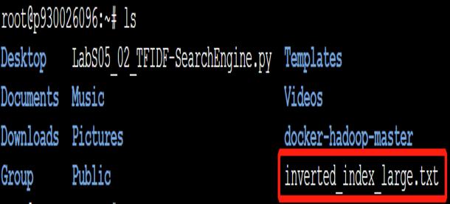
Indexing files
Term frequency
Indexing code
Indexing files
Indexing time
Ranking
Elastic search
18

Slide 19
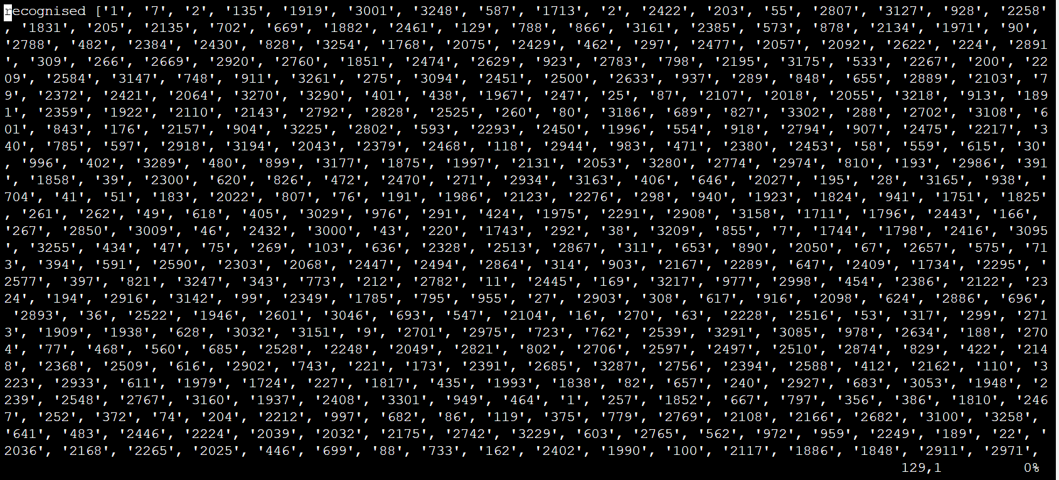
Indexing files
Term frequency
Indexing code
Indexing files
Same for cluster
Indexing time
Ranking
Elastic search
19

Slide 20
Indexing time
Term frequency
Indexing code
Size \ Environment | Single computer | Cluster (3 workers)
121M | 1.1mins | 1.3mins
1.1G | 14mins | 16mins
Indexing files
Indexing time
Ranking
Elastic search
20

Slide 21
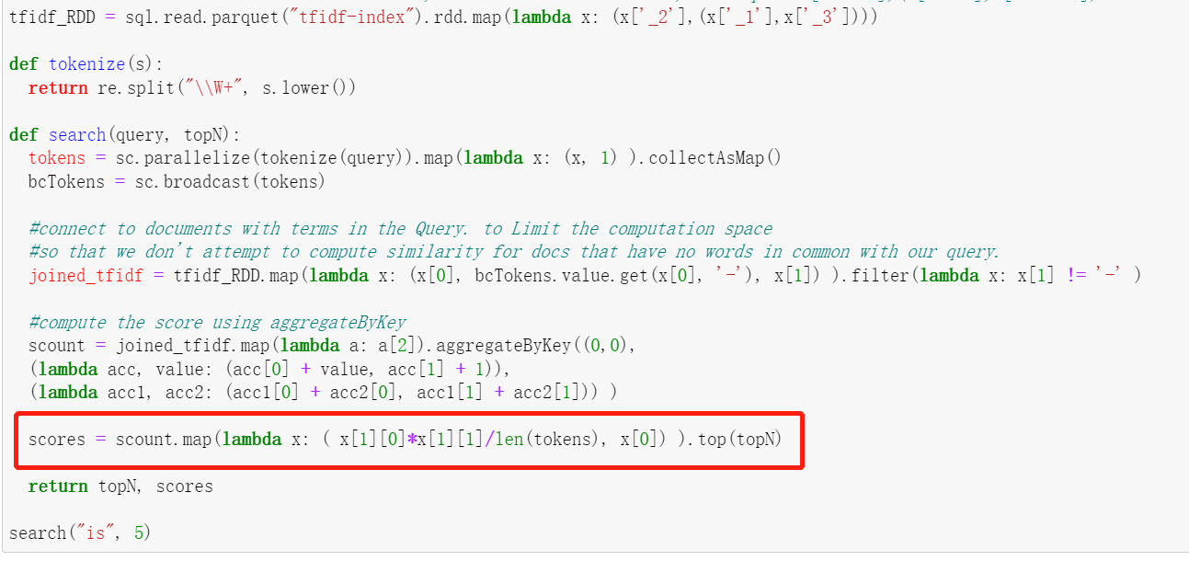
Ranking
Term frequency
Indexing code
Indexing files
Indexing time
Ranking
Elastic search
21

Slide 22
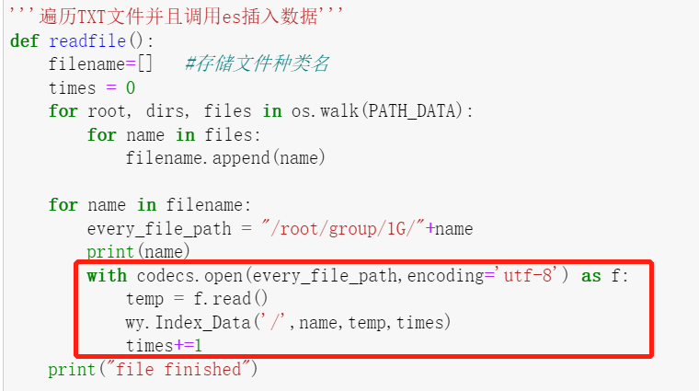
Elastic search
Term frequency
Indexing code
Indexing files
Indexing time
Ranking
Elastic search
22

Slide 23
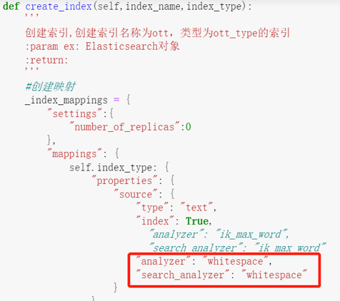
Elastic search
Term frequency
Indexing code
Indexing files
Indexing time
Ranking
Elastic search
23

Slide 24
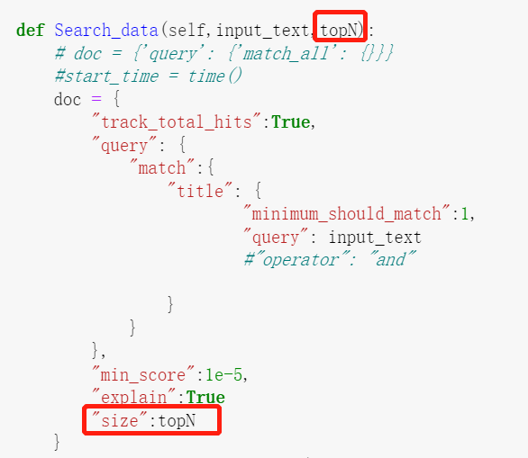
Elastic search
Term frequency
Indexing code
Indexing files
Indexing time
Ranking
Elastic search
24

Slide 25
THANKYOU
25

